Slide 1
Graphics, Tables and Basic Statistics (Chapter 3)
Lecture Objectives :
Review approaches to visually displaying Data.
Graphics that display key statistical features of measurements from a sample.
Define the distribution of a set of data.
Review common basic statistics.
  Extremes (Minimum and Maximum)
  Central Tendency ( Mean, Median)
  Spread (Range, Variance, Standard Deviation)
Review not so common basic statistics.
  Extremes (upper and lower quartiles)
  Central Tendency (Mode, Winsorized Mean)
  Spread (Interquartile Range)

Slide 2

Graphics
The visual portrayal of quantitative information
Are used to:
Display the actual data table
Display quantities derived from the data
Show what has been learned about the data from other analyses
Allow one to see what may be occurring in the data over and above what has already been described
Graphical Display
Objectives
Tabulation
Description
Illustration
Exploration
“A picture is worth a thousand words…”

Slide 3
Objectives
As you create graphics keep the following in mind.
Avoid distortion of the true story.
Induce the viewer to think about the substance, not the graph.
Reveal the data at several layers of detail.
Encourage the eye to compare different pieces.
Support the statistical and verbal descriptions of the data.

Slide 4
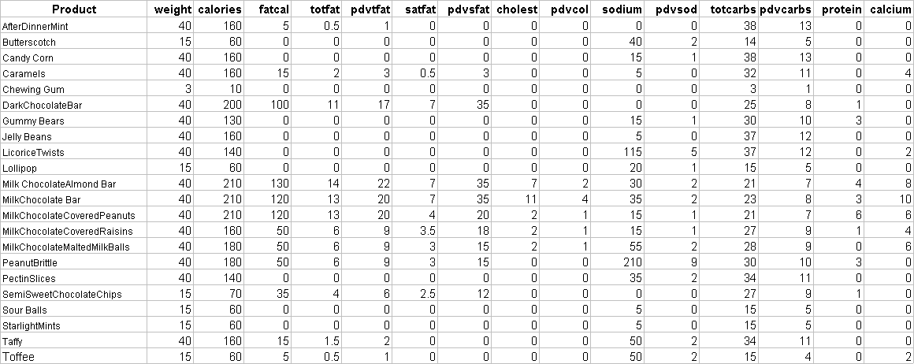
Nutrient Profiles for Selected Candy
Chocolate Manufacturers Association
National Confectioners Association
7900 Westpark Blvd. Suite A 320, McLean, Virginia 22102
URL: http://www.candyusa.org/nutfact.html
Standard data format
Qualitative characteristic
Quantitative characteristics

Slide 5
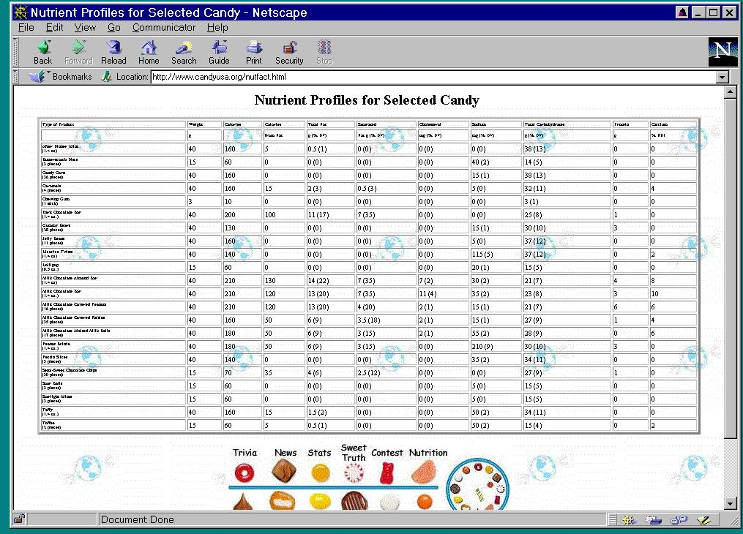
Example Data
STA6166-2-<number>

Slide 6
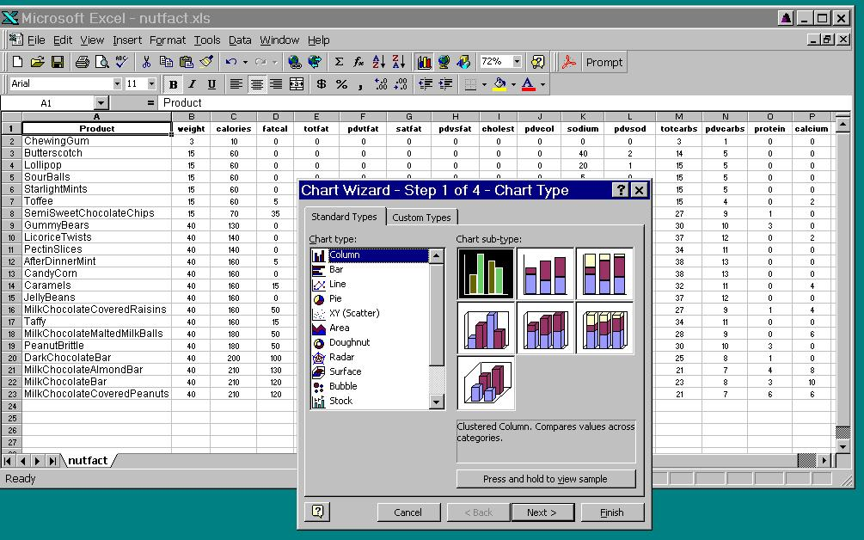
Candy data as Excel spreadsheet

Slide 7
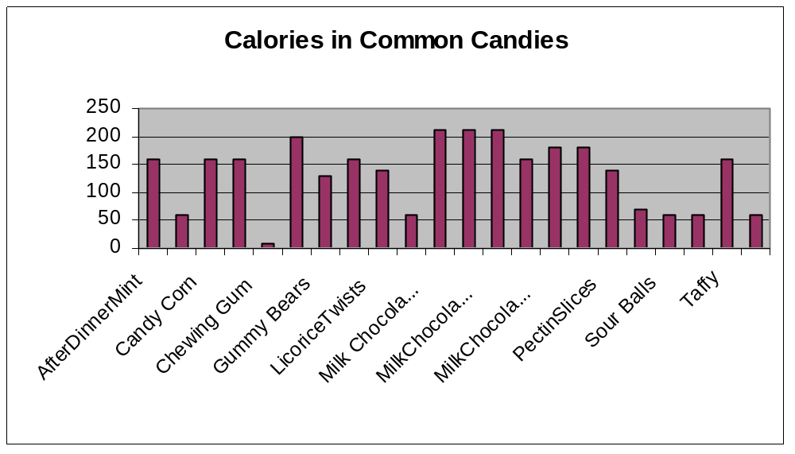
Column chart
Display the data table
What are the problems with this graph?

Slide 8
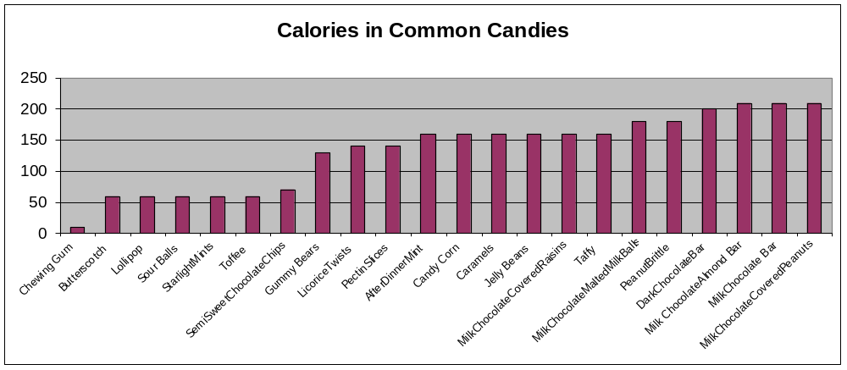
Alternate Display
Sorting and expanding the scale of the graph allows all labels to be seen as well as displaying a characteristic of the data.

Slide 9
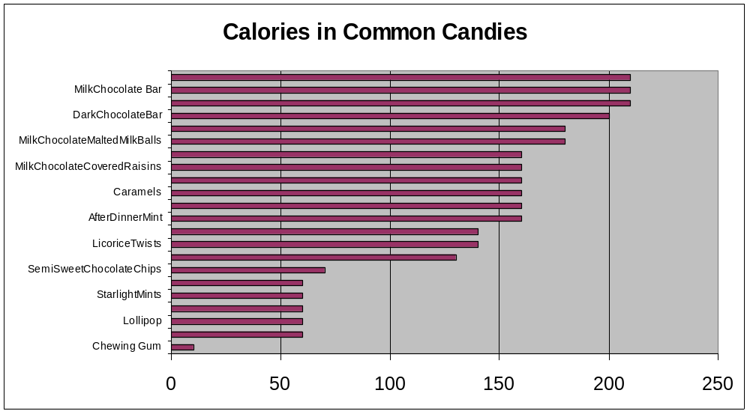
Vertical Display of Data
In this case, a vertical display allows better comparison of calorie amounts.

Slide 10
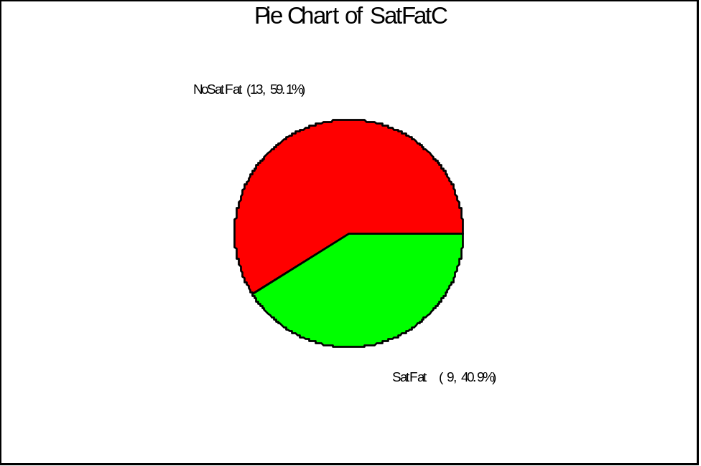
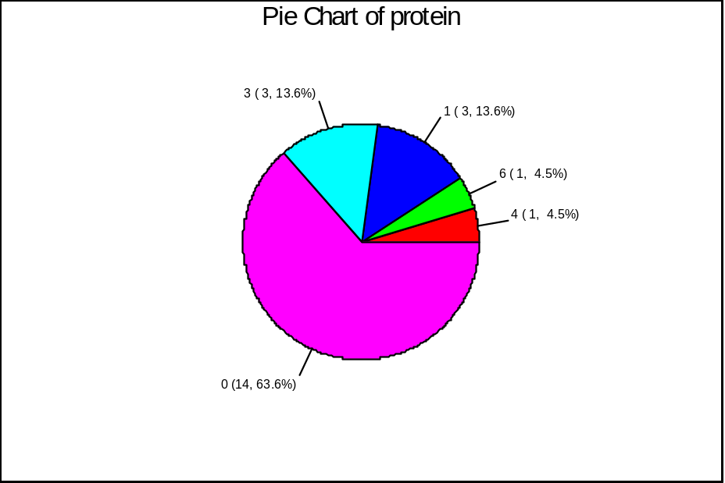
Pie Charts
A pie chart is good for making relative comparisons among pieces of a whole.

Slide 11
Statistical Uses of Graphics
Describe Distributions of Measurements
Box & Whisker plot (Boxplot)
Histogram
Compare Distributions
Multiple Box & Whisker plots
Associations and Bivariate Distributions
Scatter plot
Symbolic scatter plot
Multidimensional Data Displays
All pairwise scatter plot
Rotating scatter plot
Graphical Methods in Support of Statistical Inference
Regression lines
Residual plots
Quantile-quantile plots
Cumulative distribution function plots
Confidence and prediction interval plots
Partial leverage plots
Smoothed curves
Most of these will be demonstrated at some point in the course.

Slide 12
Basic Statistics
Before we get more into statistical uses of graphics, we need to define some basic statistics. These statistics are typically referred to as “descriptive statistics”, although as we will see, they are much more than that. These basic statistics address specific aspects of the distribution of the data.
  What is the range of the data?
  When we sort the data, what number might we see in the “middle” of the range of values?
  What number tells us over what sub range do we find the bulk of the data ?
We will use the calorie data to illustrate.

Slide 13
Extremes
First, if we sort the data we can immediately identify the extremes.
Extremes
Minimum(calories) = 10
Maximum(calories) = 210
The minimum and maximum are “statistics”.
Reminder: A statistic is a function of the data. In this case, the function is very simple.

Slide 14
Range
Range: the difference between the largest and smallest measurements of a variable.
Extremes
Minimum(calories) = 10
Maximum(calories) = 210
Range = 210-10 = 200
Tells us something about the spread of the data.
The middle of the range is a measure of the “center” of the data.
Midrange = minimum + (Range/2)
=10 + 200/2
=110
Is it a “good” measure of the center of the data?

Slide 15
Measures of Central Tendency
Estimate the value that is in the center of the “distribution” of the data .
Median = middle value in the sorted list of n numbers: at position (n+1)/2
= unique value at (n+1)/2 if n is an odd number or
= average of the values at n/2 and n/2+1 if n is even
= (160 + 160)/2 = 160
Mean = sum of all values divided by number of values (average)
= (10 + 60 + 60 + 60 + … + 210 + 210)/22
= 133.6
Trimmed mean = mean of data where some fraction of the smallest and largest data values are not considered. Usually the smallest 5% and largest 5% values (rounded to nearest integer) of data are removed for this computation.
= 136.0 (with 10% trimmed, 5% each tail).
Again – these are statistics (functions of the data)

Slide 16
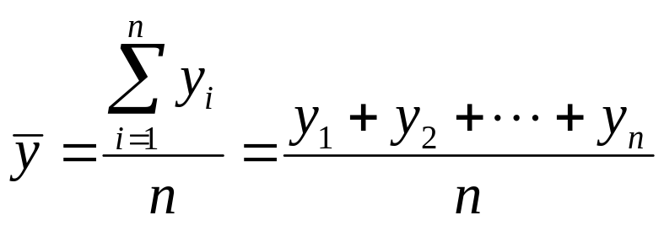
Mathematical Notation
We will need some mathematical notation if we are to make any progress in understanding statistics. In particular, since all statistics are functions of the data, we should be able to represent these statistics symbolically as equations using mathematical notation.
Let Y be the symbolic name of a random variable (e.g. a placeholder for the true name of a variable – weight, gender, time, etc.) Let y_{i} symbolically represent the i-th value of variable Y, observed in the sample. Let the symbol, Σ, represent the mathematical equation for summation. Then the sample mean can be expressed as:
Number of observations
Symbolic “name” for sample mean

Slide 17
Quartiles
Suppose we divide the sorted data into four equal parts. The values which
separate the four parts are known as the quartiles. The first or lower quartile
Q1, is the 25th percentile of the sorted data, the second quartile, Q2, is the median and the third or upper quartile, Q3, is the 75th percentile of the data. Because the sample size integer, n+1, does not always divide easily by 4, we do some estimating of these quartiles by linear interpolation between values.
Here n=22, (n+1)/4=23/4=5.75, hence Q1 is three quarters between the 5th and 6th observations in the sorted list. The 5th value is 60 and the 6th value is 60, thus
60 + .75(60-60)=60.
For Q2, (n+1)/2 = 23/2 = 11.5, e.g. half way between the 11th and 12th obs.
Q2 = 160 + .5(160-160) = 160.
For Q3, 3(n+1)/4 = 3(23)/4 = 69/4 = 17.25, e.g a quarter of the way between the 17th and 18th observations.
Q3 = 180 + .25(180-180) = 180

Slide 18
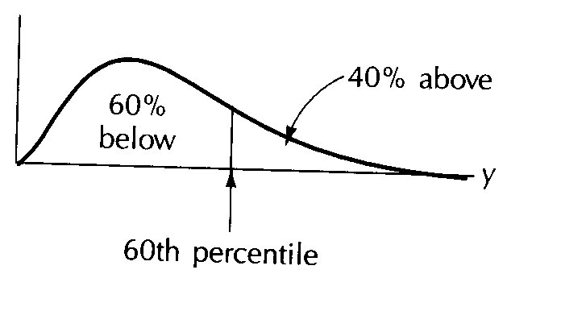
Percentiles
100p^{th} Percentile: that value in a sorted list of the data that has approx p100% of the measurements below it and approx (1-p)100% above it. (The p quantile.)
Distribution function
0 < p < 1
Examples:
Q1 = 25th percentile
Q2 = 50th percentile
Q3 = 75th percentile
Ott & Longnecker suggest finding a general 100p^{th} percentile via a complicated graphical method (pp. 87-90).
We will relegate these elaborate calculations to software packages…
We will however return to this later when we discuss QQ-Plots.

Slide 19
Simplified Quartiles
A simpler way to find Q1 & Q3 is as follows:
Order the data from the lowest to the highest value, and find the median.
Divide the ordered data into the lower half and the upper half, using the median as the dividing value. (Always exclude the median itself from each half.)
Q1 is just the median of the lower half.
Q3 is just the median of the upper half.
Ex: For the candy data we still get Q1=60 and Q3=180.
Ex: {3, 4, 7, 8, 9, 11, 12, 15, 18}.
We get Q1=(4+7)/2=5.5 and Q3=(12+15)/2=13.5.

Slide 20
Measures of Variability
Range
Interquartile Range
Variance
Standard Deviation
Interquartile Range (IQR): Difference between the third quartile (Q3) and the first quartile (Q1).
Quartiles:
Q1 = 25th = 60
Q2 = 50th = median = 160
Q3 = 75th = 180
IQR = Q3-Q1 = 180 - 60 = 120

Slide 21
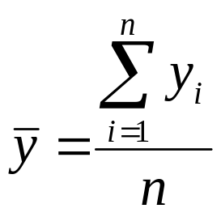
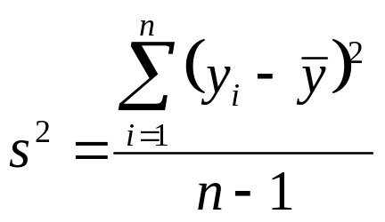
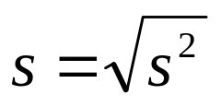
Variance and Standard Deviation
Variance: The sum of squared deviations of measurements from their mean divided by n-1.
Sample Mean
Standard Deviation: The square root of the variance.
Rough approximation for large n: s≈range/4.
These measure the spread of the data.

Slide 22
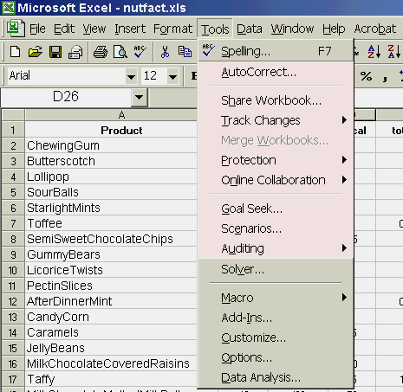
Using Excel Data Analysis Tool
Under the “Tools” menu in Excel there is a tool called “Data Analysis”. This tool is not normally loaded when the Excel default installation is used so you may have to load it yourself. This will require the Excel CD. Use the Tools > Add Ins option, select the Data Analysis tool and add it to your menu.

Slide 23
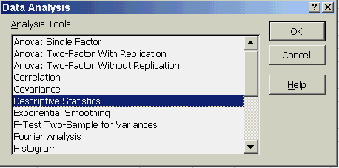
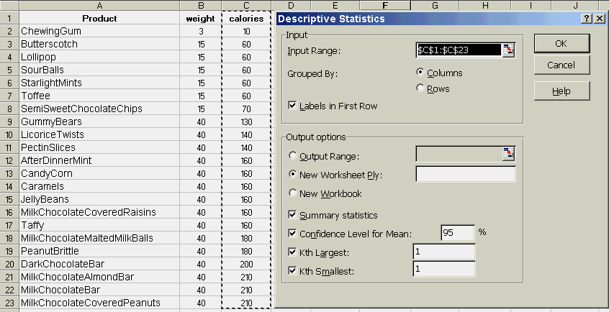
Excel Data Analysis Tool
Select the Data Analysis Tool
Select Descriptive Statistics
The menu below appears.
Enter the Input Range and check the output options desired.

Slide 24
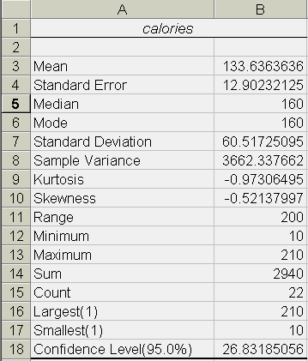
Excel Descriptive Statistics Output
You should be able to easily identify the basic statistics we have described so far.
Note: the variance is not in this list. This is typical of statistics packages. Since the variance is simply the square of the Standard Deviation, it is often considered redundant.
Learn to use the Excel Help files. Type “Statistic” in the Excel Help Keyword dialog for a list of helps available.

Slide 25
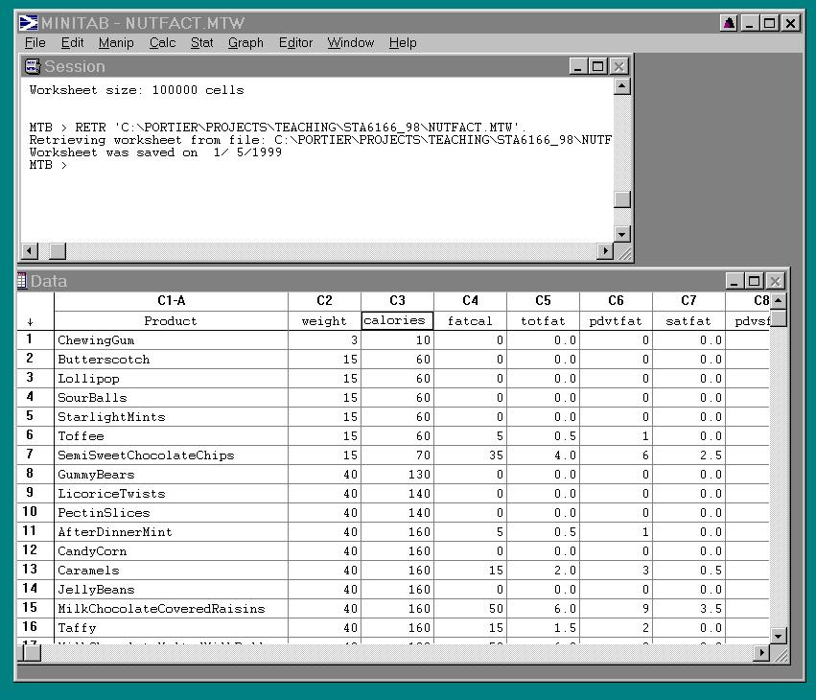
Importing a text data file in standard format into Minitab
Pull down menus
Session worksheet with script commands
Spreadsheet like data area

Slide 26
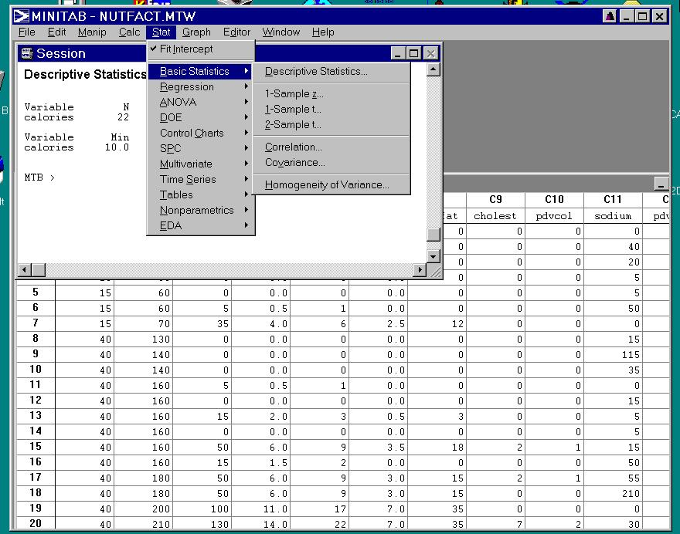
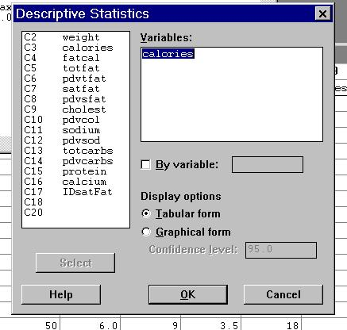
Computing Descriptive Stats
Descriptive Statistics
Variable N Mean Median TrMean StDev SEMean
calories 22 133.6 160.0 136.0 60.5 12.9
Variable Min Max Q1 Q3
calories 10.0 210.0 60.0 180.0

Slide 27
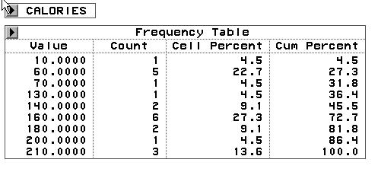
Frequency Table
A tabular representation of a set of data.
A frequency table also describes the distribution of the data and facilitates the estimation of probabilities.
The “Histogram” dialog in the Excel Data Analysis Tool can be used to create this table. But it is not straightforward.
Mode = most abundant

Slide 28
Stem and Leaf Plot
Rough grouping or “binning” of the data.
Histogram of calories N = 22
Midpoint Count
20 1 *
40 0
60 5 *****
80 1 *
100 0
120 0
140 3 ***
160 6 ******
180 2 **
200 1 *
220 3 ***
A printer graph of the frequency table.
Easy to do by hand.
Quick visualization of the data.

Slide 29
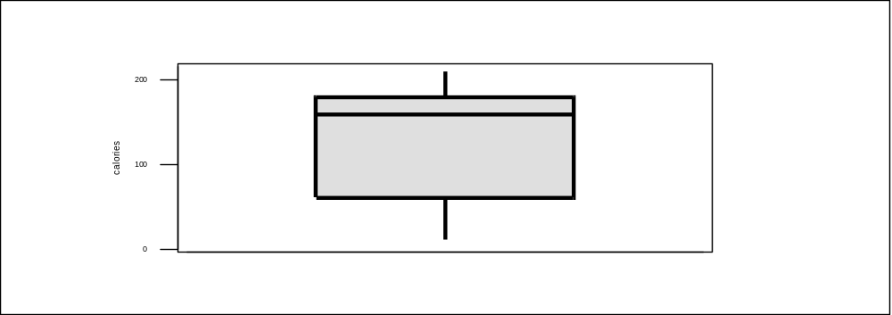
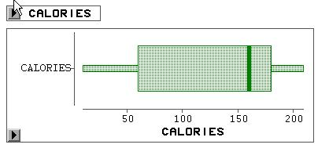
Box Plot for Calories
A visualization of most of the basic statistics.
Maximum
Interquartile
range
75th percentile (Q3)
Median (Q2)
25th percentile (Q1)
Minimum
Box Plot
(SAS Proc Insight)
Is there an Excel Tool? No.

Slide 30
Percentiles
100p^{th} Percentile: that value in a sorted list of the data that has approx p100% of the measurements below it and approx (1-p)100% above it. (The p quantile.)
Smoothed histogram
0 < p < 1
Examples:
Q1 = 25th percentile
Q2 = 50th percentile
Q3 = 75th percentile
A distribution is said to be symmetric if the distance from the median to the 100p^{th} percentile is the same as the distance from the median to the 100(1-p)^{th} percentile. Otherwise the distribution is said to be skewed.
In the case above, the distribution is skewed to the right since the right tail is longer than the left tail.

Slide 31
Frequency Histogram
A graphical presentation of the frequency table where the relative areas of the bars are in proportion to the frequencies.
This is a frequency histogram
Frequency
9
8
7
y
6
c
n
5
e
u
q
4
e
r
F
3
2
1
0
0
5
0
1
0
0
1
5
0
2
0
0
c
a
l
o
r
i
e
s
Bin width

Slide 32
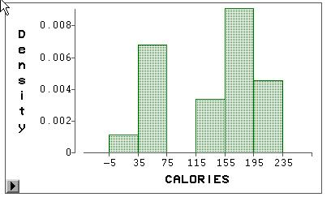
Density Histogram
A density histogram (or simply a histogram) is constructed just like a frequency histogram, but now the total area of the bars sums to one. This is accomplished by rescaling the vertical axis. Instead of frequencies, the vertical axis records the rescaled value of the density.
Histograms have important ties to probability.
Sum of shaded area is equal to one.

Slide 33
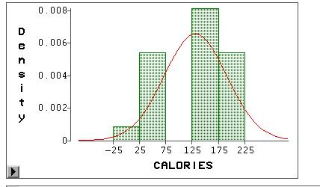
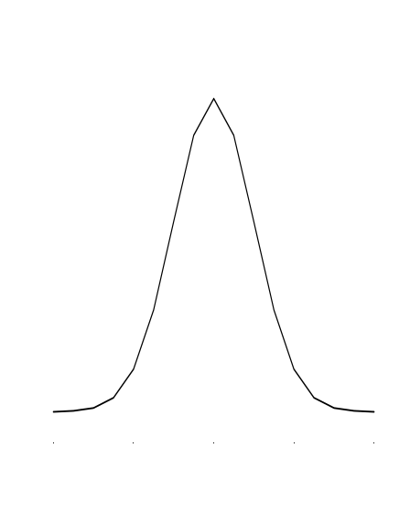
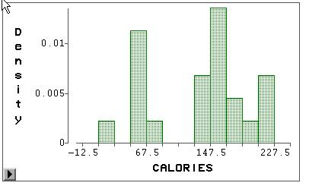
Number of Bins for Histograms
Smoothed histogram or density curve.
Six bins
Five bins
How we view the “distribution” of a dataset can depend on how much data we have and how it is binned.
Eleven bins

Slide 34
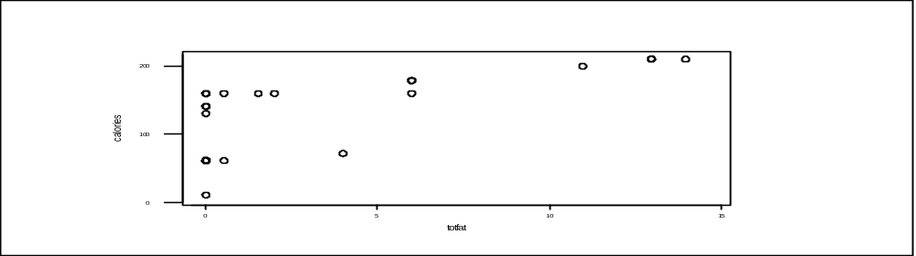
Scatterplot
Graphics to examine relationships
Is the relationship linear or non-linear?
Beware, changing the relative lengths of the axes can change how the relationship is perceived.

Slide 35
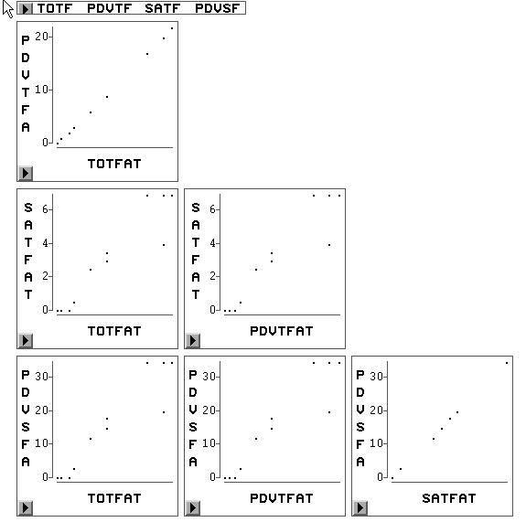
Matrix Plot
View multiple variables at one time.

Slide 36
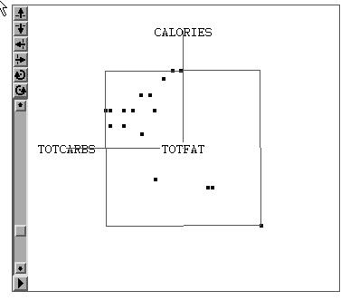
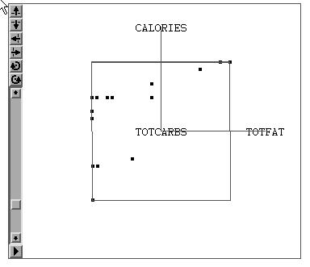
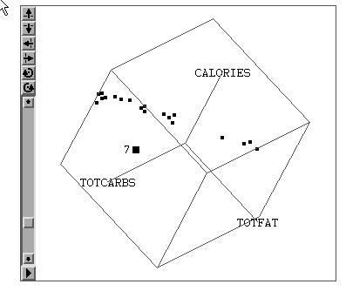
Three-D
Views
Brushing the plot to identify interesting points.

